Slide 1
Sales Data Analysis & Forecasting
By Vince Coletti

Slide 2
The Problem
Analyse past sales to find opportunities for growth and determine if sales are projected to grow by at least 15% over the next 12 months to support the growth plan put forth by the CEO?
Notes:
The CEO has a mandate of expanding the company internationally next year. To accomplish this goal, he has determined the company’s workforce will need to expand by 20% and marketing spend will need to increase by 15%. Annual revenue must be projected to grow by at least 15% for the next 12 months to accommodate the increase in costs and time it will take for marketing to take effect and the international expansion to be fully realized. With a high degree of accuracy, what will the company’s projected revenue be next year; and does projected revenue support the CEO’s expansion plans?

Slide 3
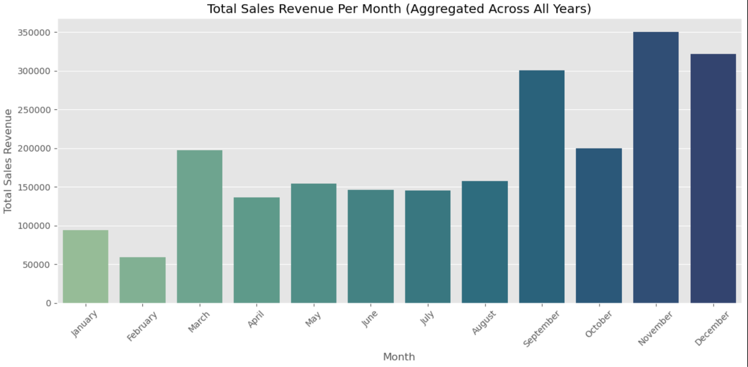
The Solutions
1) Increase post holiday sales.
Notes:
The fastest way to grow revenue would be to address our lowest sales months of January and February. To increase sales in these months without cannibalizing holiday sales, it would be beneficial to assess the sales volume left in customer's carts after the holidays and aggressively deploying email campaigns to push those customers over the finish line. We could also release new products in January to drive new sales.

Slide 4
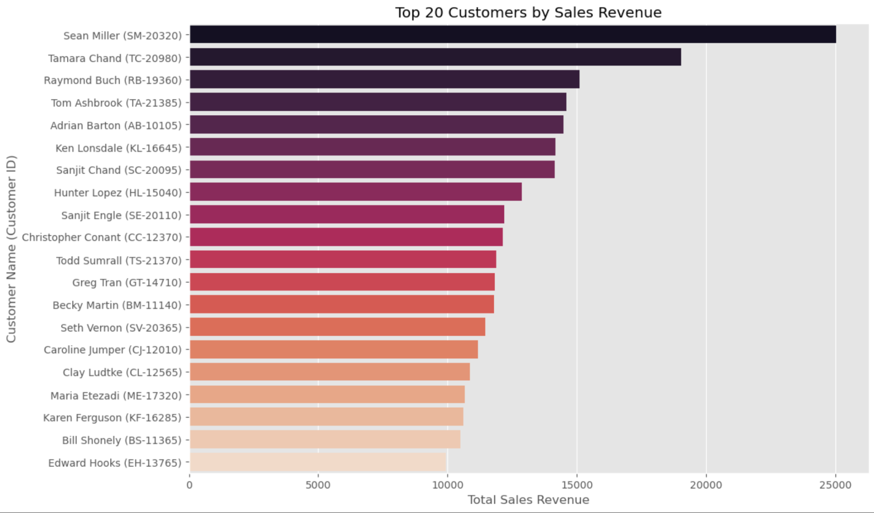
The Solutions
2) Target top customers
Notes:
We can use targeted ad campaigns aimed at our top customers and offer them referral bonuses and exclusive discounts. To take it a step further to reward these customer's loyalty, we can explore a brand ambassador program to incentivize these customers to drive sales for us.

Slide 5
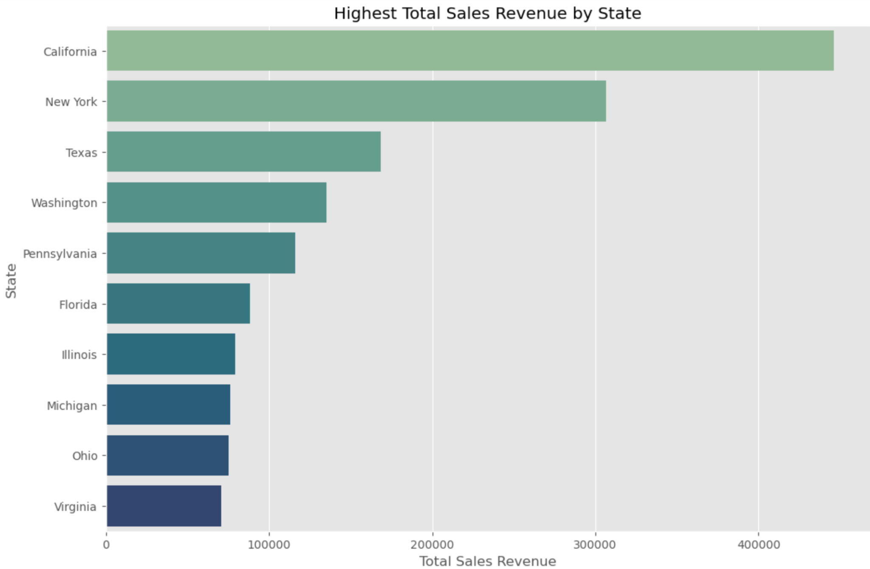
The Solutions
Focus on highest selling markets
Notes:
In analyzing state and city data, we find that although New York produces the highest sales revenue of any city, California produces more sales revenue than the state of New York due to 3 California cities being in the top 10 of sales revenue. I would recommend deploying more marketing dollars in California and New York City only to maximize ROI of the increased ad spend.

Slide 6
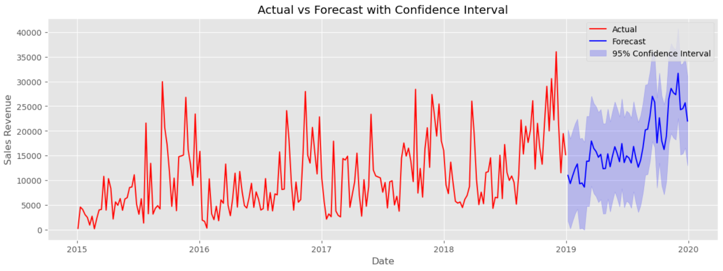
Can We Move Forward?
Yes, growth is projected to grow by at least 25%
Notes:
The SARIMA Model had the lowest prediction; an increase of 25.09% in sales revenue next year. This is well above our required threshold of 15% annual growth, so the data shows we can proceed with the expansion.

Slide 7
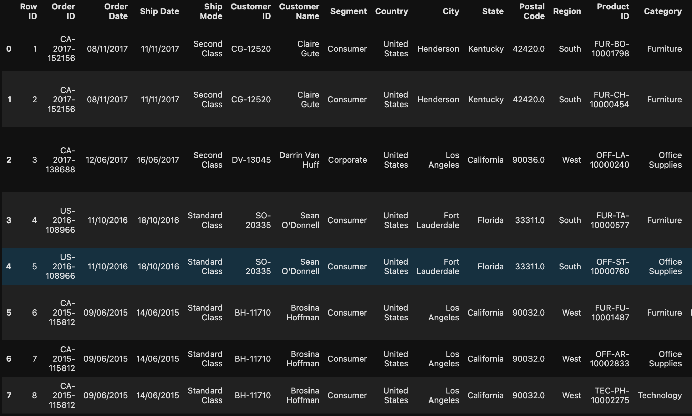
The Data
Notes:
5 years of company sales data

Slide 8
Data Cleaning
Original dataset came in an Excel file with 9,800 rows, and 18 columns. Most of the data was categorical, and there were missing values.
Check duplicates
Missing values were handled appropriately
Dropped columns that provided no further information.
'Zip Codes' values were converted to strings to ensure that any potential leading 0's were not dropped.
Aggregate sales by week and month to draw insights
Notes:
Values were missing from the tables for various reasons.
'Churn Category' & 'Churn Reason' missing values were because the rest of the observations did not churn so filled missing values for these columns to 'Did Not Churn'
'Offer' missing values were filled with 'Unknown/None'
After inspecting which customers had internet service, I found that the missing values in 'Internet Type' was due to those customers not receiving internet services from Telco. Filled missing values with 'None'.
'Count' & 'Quarter' columns were dropped as all values were 1 & Q3 respectively and provide no further value to this analysis.
'Lat Long', 'Latitude', & 'Longitude' columns were dropped. We already have State, City, & Zip. For our analysis, coordinate data is not beneficial.

Slide 9
Exploratory Data Analysis
Notes:
I looked at a number of different features and the relationships between them, and the most relevant data, that actually has actionable insights, are represented in these plots that I showed earlier.

Slide 10
Data Preprocessing
Aggregate by week & set index to our dates
Feature Engineering
Check for stationarity
Check for seasonality
Split the data

Slide 11
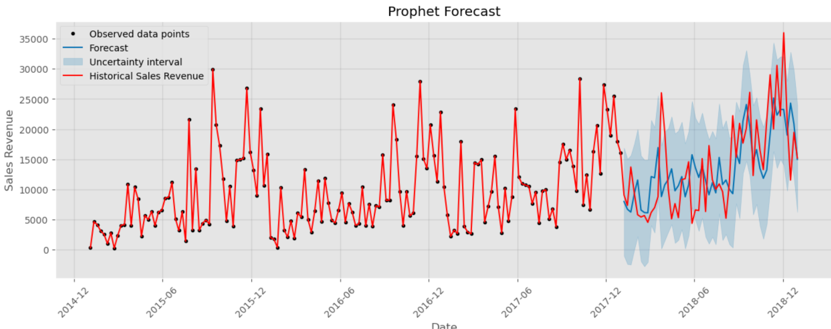
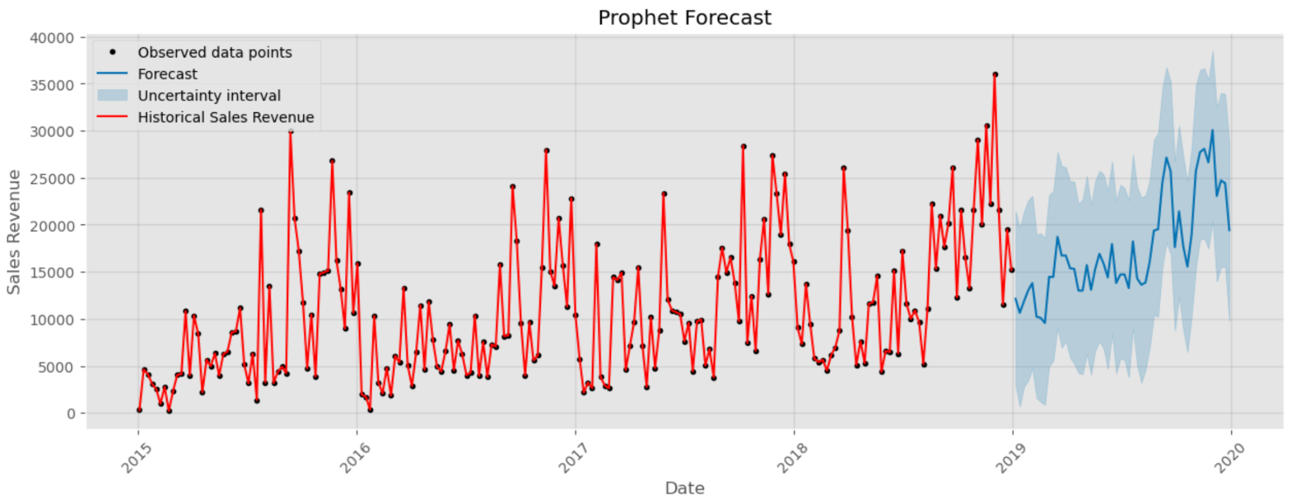
Modeling - Prophet

Slide 12
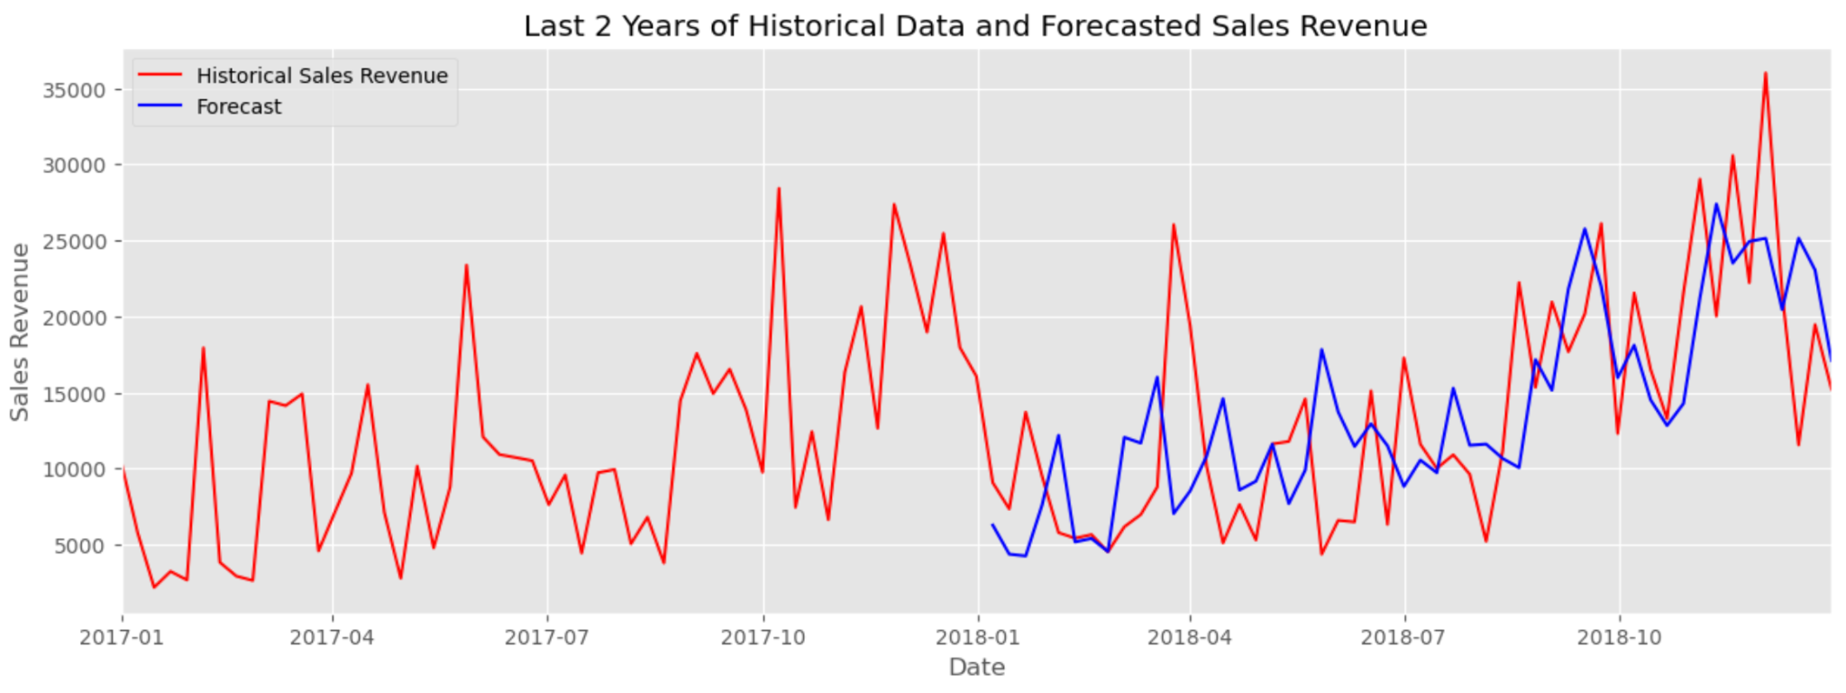
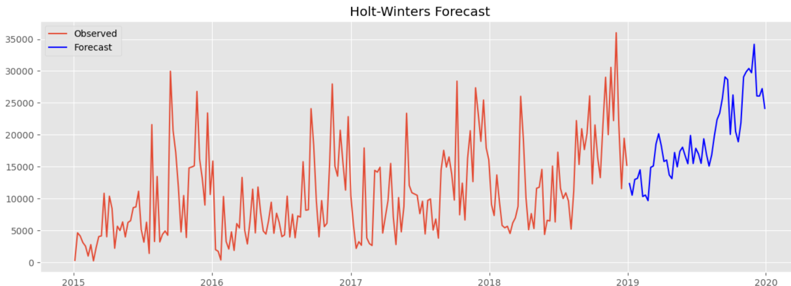
Modeling - Holt Winters

Slide 13
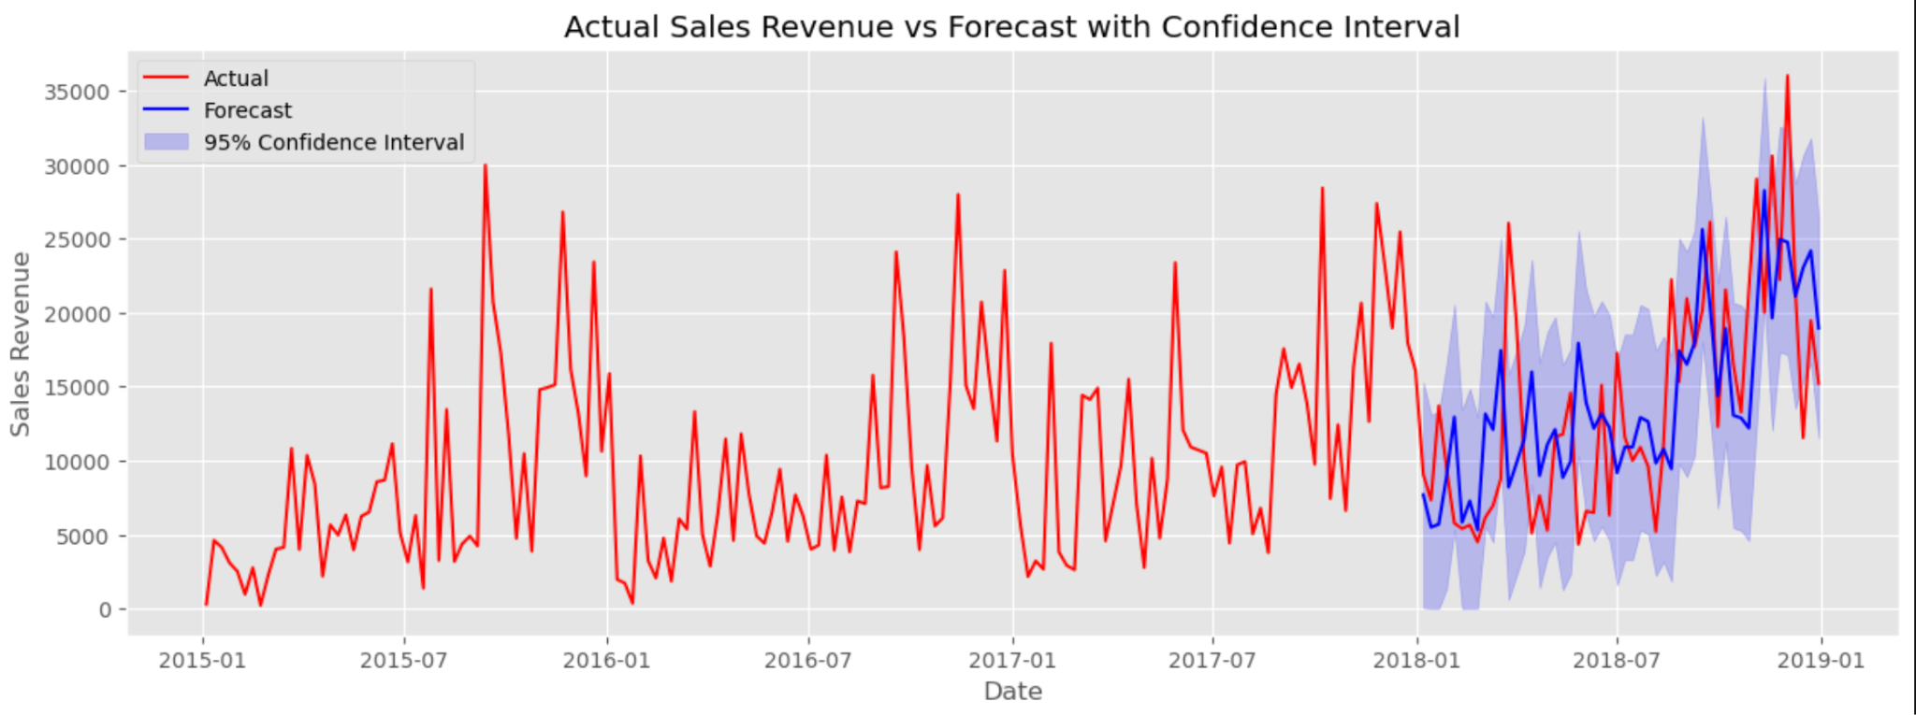
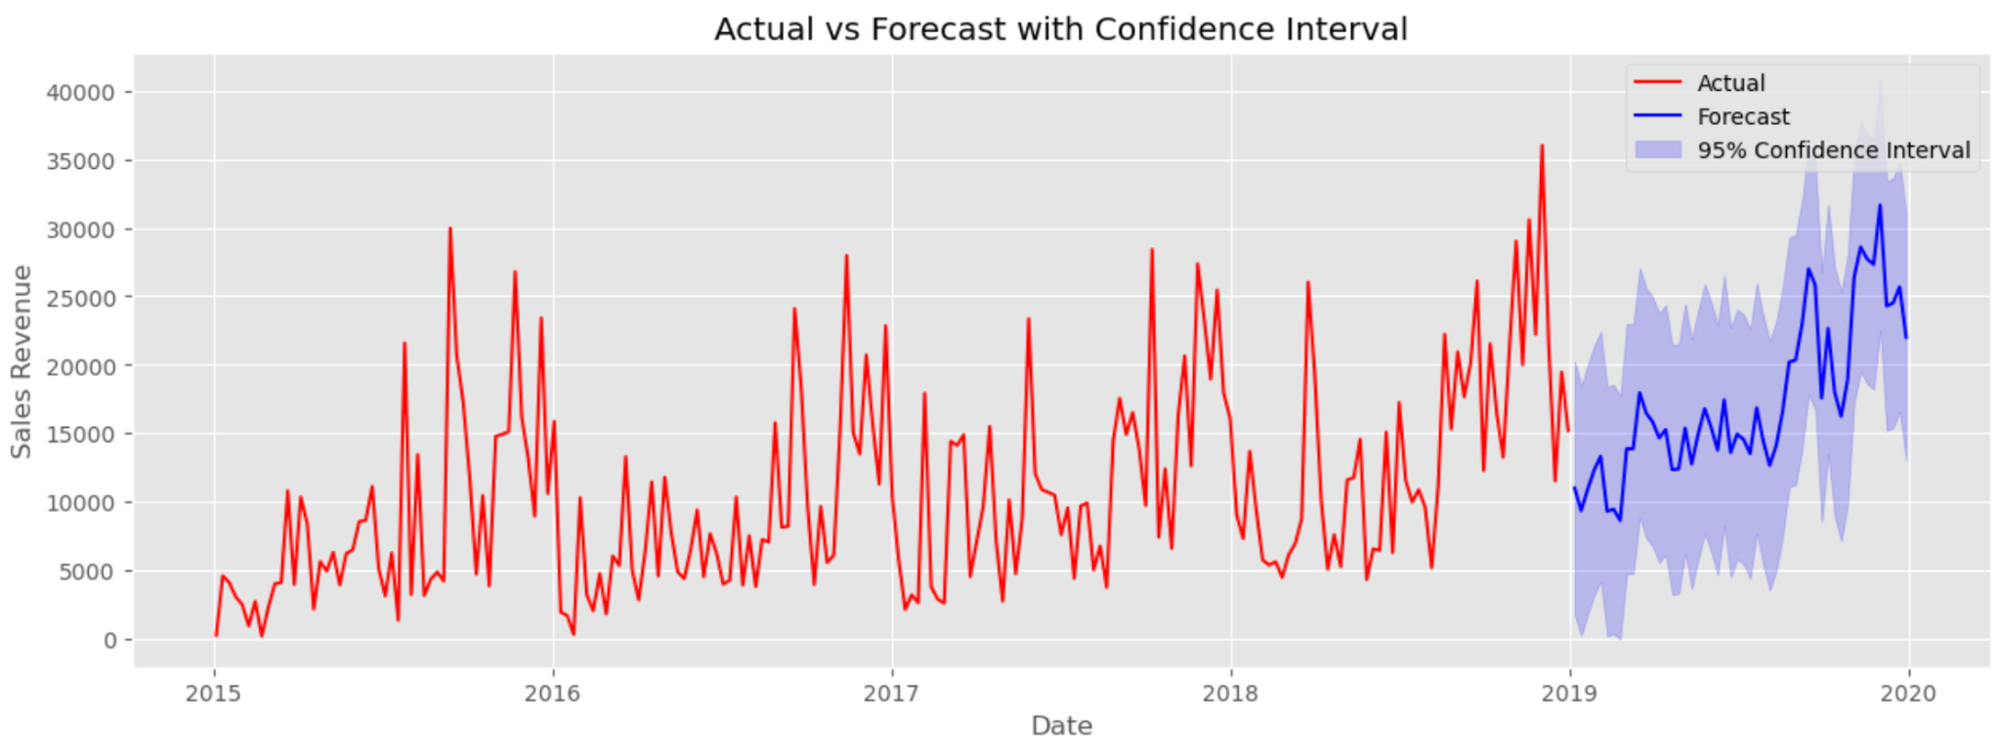
Modeling - SARIMA

Slide 14
Prophet
25.8% Growth
Holt Winters
39.4% Growth
SARIMA
25.1% Growth
Forecasts

Slide 15
Future Research
After making recommended changes, collect more data to view the growth in sales and how the models change.
Track additional metrics going forward on sales generated from brand ambassadors

Slide 16
Questions?

